Slide 1
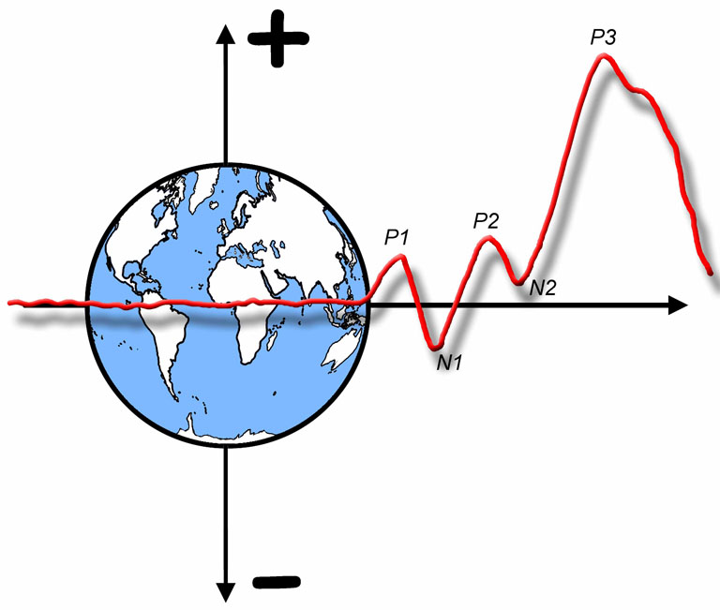

The ERP Boot Camp
Plotting & Measurement

Slide 2
Plotting- The Right Way
To-be-compared waveforms overlaid with different colors and different line types
Legend in figure
Time Zero
Time ticks on baseline for every waveform
Electrode Site
Voltage calibration
aligned with waveform
Calibration size
and polarity
Baseline shows 0 µV
Notes:
Adapted from Figure 6.1 in Luck, Steven J. (2005). An introduction to the Event-Related Potential Technique. Cambridge, MA: MIT Press.© MIT Press. This material may be used for nonprofit research and education purposes only, and it may not be reprinted or distributed in any form including print and electronic forms.
Other content: © S. J. Luck. All Rights Reserved. May be used for nonprofit educational purposes if this copyright notice is included. Permission must be obtained from the copyright holder(s) for any other use.

Slide 3
Plotting- Basic Principles
You must show the waveforms (SPR rule)
You need to show enough sites so that experts can figure out underlying component structure
I often show just one site for a cognitive audience when component can be isolated (N2pc or LRP)
In most cases, don’t shown more than 6-8 sites (topo map instead)
A prestimulus baseline must be shown
Usually 200 ms (minimum of 100 ms for most experiments)
If you don’t see a baseline, the study is probably C.R.A.P (Carelessly Reviewed Awful Publication)
Overlay the key waveforms
In most cases, show both original waveforms and difference waves
Notes:
© S. J. Luck. All Rights Reserved. May be used for nonprofit educational purposes if this copyright notice is included. Permission must be obtained from the copyright holder(s) for any other use.

Slide 4
Choosing Time Windows and Electrodes
In most cases, ERP measurement involves selecting a time window and a set of electrode sites
If you use the effects observed in the data to guide the choice of time window and electrode sites, you will bias your results
Large increase in probability of Type I error (false positive)
But let’s forget about this issue for now
Once we’ve explained the basic options for measuring amplitudes and latencies, we will consider how to select time windows and electrode sites
Notes:
© S. J. Luck. All Rights Reserved. May be used for nonprofit educational purposes if this copyright notice is included. Permission must be obtained from the copyright holder(s) for any other use.

Slide 5
Measuring ERP Amplitudes
Basic options
Peak amplitude
Or average around peak
Or local peak amplitude
Mean/area amplitude
Notes:
Figure 6.2 from Luck, Steven J. (2005). An introduction to the Event-Related Potential Technique. Cambridge, MA: MIT Press.© MIT Press. This material may be used for nonprofit research and education purposes only, and it may not be reprinted or distributed in any form including print and electronic forms.
Other content: © S. J. Luck. All Rights Reserved. May be used for nonprofit educational purposes if this copyright notice is included. Permission must be obtained from the copyright holder(s) for any other use.

Slide 6
Mean and Area
Area = A + B = 35.39 µVms
Positive Area = B = 1.49 µVms
Negative Area = A = 33.90 µVms
Integral = B - A = 32.41 µVms
Mean = Integral ÷ 100 ms = .3241 µV
Notes:
Adapted from Figure 9.4 in Luck, S.J. (2014). An Introduction to the Event-Related Potential Technique, Second Edition. Cambridge, MA: MIT Press. © MIT Press.
This material may be used for nonprofit research and education purposes only, and it may not be reprinted or distributed in any form including print and electronic forms.

Slide 7
Mean and Area
To avoid confusion, I like to use the term “rectified area” instead of “area”
Notes:
Adapted from Figure 9.4 in Luck, S.J. (2014). An Introduction to the Event-Related Potential Technique, Second Edition. Cambridge, MA: MIT Press. © MIT Press.
This material may be used for nonprofit research and education purposes only, and it may not be reprinted or distributed in any form including print and electronic forms.

Slide 8
Why Mean is Better than Peak
Rule #1: “Peaks and components are not the same thing. There is nothing special about the point at which the voltage reaches a local maximum.”
Mean amplitude better characterizes a component as being extended over time
Peak amplitude encourages misleading view of components
Peak may find rising edge of adjacent component
Can be solved by local peak measure
Peak is sensitive to high-frequency noise
Can be mitigated by low-pass filter or “mean around peak”
Time of peak depends on overlapping components
The peak may be nowhere near the center of the experimental effect
Notes:
© S. J. Luck. All Rights Reserved. May be used for nonprofit educational purposes if this copyright notice is included. Permission must be obtained from the copyright holder(s) for any other use.

Slide 9
Individual Differences and Peaks
Peaks from three subjects in a simple visual oddball paradigm
Subject 2: Implausible that a process occurred 200 ms later for the oddball than for the standard
Subject 3: Implausible that processing of standard occurred 200 ms later for this subject than for Subjects 1 and 2
Notes:
Adapted from Figure 9.2 in Luck, S.J. (2014). An Introduction to the Event-Related Potential Technique, Second Edition. Cambridge, MA: MIT Press. © MIT Press.
This material may be used for nonprofit research and education purposes only, and it may not be reprinted or distributed in any form including print and electronic forms.

Slide 10
Why Mean is Better than Peak
Peak amplitude is biased by the noise level
More noise means greater peak amplitude
Mean amplitude is unbiased by noise level
Notes:
© S. J. Luck. All Rights Reserved. May be used for nonprofit educational purposes if this copyright notice is included. Permission must be obtained from the copyright holder(s) for any other use.

Slide 11
Peak Amplitude and Noise
Clean Waveform
Waveform + 60-Hz Noise
Notes:
© S. J. Luck. All Rights Reserved. May be used for nonprofit educational purposes if this copyright notice is included. Permission must be obtained from the copyright holder(s) for any other use.

Slide 12
Why Mean is Better than Peak
Peak at different time points for different electrodes
A real effect cannot do this
A narrower measurement window can be used for mean amplitude
Mean amplitude is linear; peak amplitude is not
Mean of peak amplitudes ≠ peak amplitude of grand average
Mean of mean amplitudes = mean amplitude of grand average
Same applies to single-trial data vs. averaged waveform
y = c + bx Simple line
y = c + b₁x₁ + b₂x₂ + b₃x₃ … Multiple regression
y = ⅓x₁ + ⅓x₂ + ⅓x₃ Averaging
y = ch1+ (-.5)ch14 Re-referencing
Notes:
© S. J. Luck. All Rights Reserved. May be used for nonprofit educational purposes if this copyright notice is included. Permission must be obtained from the copyright holder(s) for any other use.

Slide 13
Shortcomings of Mean Amplitude
You will still pick up overlapping components
A narrower window reduces this, but increases noise level
Different measurement windows might be appropriate for different subjects
This could be a source of measurement noise
Patients and controls might have different latencies, leading to a systematic distortion of the results
This is a case where peak might be better
Alternative: Signed area
Notes:
© S. J. Luck. All Rights Reserved. May be used for nonprofit educational purposes if this copyright notice is included. Permission must be obtained from the copyright holder(s) for any other use.

Slide 14
Signed Area
An advantage of choosing only positive area or negative area is that the specific measurement window no longer matters as much
Notes:
Adapted from Figure 9.4 in Luck, S.J. (2014). An Introduction to the Event-Related Potential Technique, Second Edition. Cambridge, MA: MIT Press. © MIT Press.
This material may be used for nonprofit research and education purposes only, and it may not be reprinted or distributed in any form including print and electronic forms.

Slide 15
Signed Area Example
Question: Is N2 bigger in Group A than in Group B?
Problem: How to we choose time window?
Best case scenario: Previous experiments tell us to use 250-400
Note: This matches time course of effect in the present experiment (i.e., we’re very lucky!)
Notes:
Adapted from Figure 9.3 in Luck, S.J. (2014). An Introduction to the Event-Related Potential Technique, Second Edition. Cambridge, MA: MIT Press. © MIT Press.
This material may be used for nonprofit research and education purposes only, and it may not be reprinted or distributed in any form including print and electronic forms.

Slide 16
Signed Area Example
If we use mean amplitude or integral, the time range is not quite perfect for each subject
Some cancellation for Subject A1
Missing part for Subject A2
And what if we don’t have prior research to guide choice of window?
Notes:
Adapted from Figure 9.3 in Luck, S.J. (2014). An Introduction to the Event-Related Potential Technique, Second Edition. Cambridge, MA: MIT Press. © MIT Press.
This material may be used for nonprofit research and education purposes only, and it may not be reprinted or distributed in any form including print and electronic forms.

Slide 17
Signed Area Example
Negative
Area =
207 µVms
Alternative: Just measure the area below zero (negative area)
Does not require a narrow window!
Note: Units of area are µVms or µVs
(amplitude x time)
Note: Biased measure (always >= zero)
Negative
Area =
192 µVms
Notes:
Adapted from Figure 9.3 in Luck, S.J. (2014). An Introduction to the Event-Related Potential Technique, Second Edition. Cambridge, MA: MIT Press. © MIT Press.
This material may be used for nonprofit research and education purposes only, and it may not be reprinted or distributed in any form including print and electronic forms.

Slide 18
The Baseline (reminder)
Baseline correction is equivalent to subtracting baseline voltage from your amplitude measures
Any noise in baseline contributes to amplitude measure
Short baselines are noisy
Usual recommendation: 200 ms
Need to look at 200+ ms to evaluate overlap and preparatory activity
Baseline can be significant confound
Notes:
© S. J. Luck. All Rights Reserved. May be used for nonprofit educational purposes if this copyright notice is included. Permission must be obtained from the copyright holder(s) for any other use.

Slide 19
Measuring Midpoint Latency
Basic options
Peak latency
Or local peak latency
50% area latency
Notes:
Figure 6.2 from Luck, Steven J. (2005). An introduction to the Event-Related Potential Technique. Cambridge, MA: MIT Press.© MIT Press. This material may be used for nonprofit research and education purposes only, and it may not be reprinted or distributed in any form including print and electronic forms.
Other content: © S. J. Luck. All Rights Reserved. May be used for nonprofit educational purposes if this copyright notice is included. Permission must be obtained from the copyright holder(s) for any other use.

Slide 20
Better Example of 50% Area
Rare Minus Frequent
Notes:
© S. J. Luck. All Rights Reserved. May be used for nonprofit educational purposes if this copyright notice is included. Permission must be obtained from the copyright holder(s) for any other use.

Slide 21
Shortcomings of Peak Latency
Peak may find rising edge of adjacent component
Can be solved by local peak measure
Peak is sensitive to high-frequency noise
Can be partially mitigated by low-pass filter
Time of peak depends on overlapping components
Terrible for broad components with no real peak
Biased by the noise level
More noise => nearer to center of measurement window
Not linear
Difficult to relate to reaction time
Notes:
© S. J. Luck. All Rights Reserved. May be used for nonprofit educational purposes if this copyright notice is included. Permission must be obtained from the copyright holder(s) for any other use.

Slide 22
50% Area Latency
Uses entire waveform in determining latency
Robust to noise
Not biased by the noise level
Works fine for broad waveforms with no real peak
Linear
Easier to relate to RT
Almost the same as median
Shortcomings
Measurement window must include entire component
Strongly influenced by overlapping components
Requires monophasic waveforms
Works best on big components and/or difference waves
Notes:
© S. J. Luck. All Rights Reserved. May be used for nonprofit educational purposes if this copyright notice is included. Permission must be obtained from the copyright holder(s) for any other use.

Slide 23
Relating Midpoint Latency to RT
Probability Distribution of RT
17% of RTs at 350 ms
25% of RTs at 400 ms
Probability of Reaction Time
7% of RTs at 300 ms
Time
Notes:
Figure 9.8 from Luck, S.J. (2014). An Introduction to the Event-Related Potential Technique, Second Edition. Cambridge, MA: MIT Press. © MIT Press.
This material may be used for nonprofit research and education purposes only, and it may not be reprinted or distributed in any form including print and electronic forms.

Slide 24
Relating Midpoint Latency to RT
Peak latency is related to mode of RT distribution, not mean or median
ERP Amplitude
Time
Notes:
© S. J. Luck. All Rights Reserved. May be used for nonprofit educational purposes if this copyright notice is included. Permission must be obtained from the copyright holder(s) for any other use.

Slide 25
Relating Midpoint Latency to RT
Typical RT probability distributions across different conditions
P3 peak latency usually differs less across conditions than mean RT
Notes:
Figure 6.4 from Luck, Steven J. (2005). An introduction to the Event-Related Potential Technique. Cambridge, MA: MIT Press.© MIT Press. This material may be used for nonprofit research and education purposes only, and it may not be reprinted or distributed in any form including print and electronic forms.
Other content: © S. J. Luck. All Rights Reserved. May be used for nonprofit educational purposes if this copyright notice is included. Permission must be obtained from the copyright holder(s) for any other use.

Slide 26
50% Area Latency Example
Luck & Hillyard (1990)
Notes:
© S. J. Luck. All Rights Reserved. May be used for nonprofit educational purposes if this copyright notice is included. Permission must be obtained from the copyright holder(s) for any other use.

Slide 27
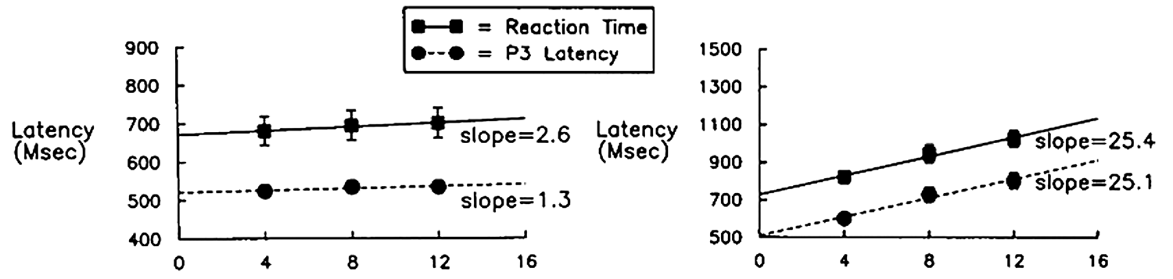
50% Area Latency Example
Luck & Hillyard (1990)
Notes:
© S. J. Luck. All Rights Reserved. May be used for nonprofit educational purposes if this copyright notice is included. Permission must be obtained from the copyright holder(s) for any other use.

Slide 28
Measuring Onset Latency
Basic options for onset of component
20% area latency
50% peak latency
Statistical threshold
First of N consecutive p<.05 points
Peak amplitude
50% of peak amplitude
Latency @ 50% of peak amplitude
Notes:
© S. J. Luck. All Rights Reserved. May be used for nonprofit educational purposes if this copyright notice is included. Permission must be obtained from the copyright holder(s) for any other use.

